Slide 1
Molecular Evolution, Genomic Epidemiology and Phylogenetics of Viruses

Slide 2
Introduction to Phylogenetics
Analysis Module

Slide 3
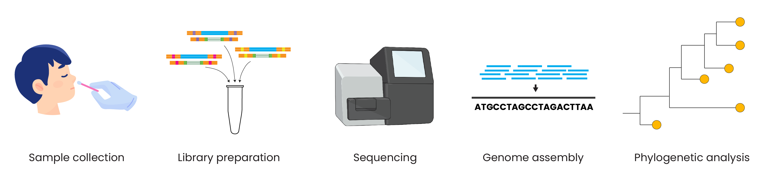
Genomic epidemiology workflow
BioRender.com
Pixel True https://www.pixeltrue.com/about, CC BY-SA 4.0, via Wikimedia Commons
Notes:
Feedback:
- I will provide an overview figure to go here, this is a placeholder for now

Slide 4
What is phylogenetics?
The study of the evolutionary history of a species or group of species using genomes or physical traits.
We build phylogenies to explore how organisms are related to each other
We examine common and different traits
For pathogens, we can use their genomes to see how they are spreading through space and time
Notes:
Has anybody heard of phylogenetics?
Before the advent of genomics, we used to work out how organisms were related by their physical traits, or morphology, and this is a very old science.
This is much harder to do with micro-organisms – we can only really do broad classifications based on morphologies (eg gram positive or gram negative)
With genomes we can explore relatedness in much higher resolution
Now will just be discussing genomes and genetic change, not interested in physical change
The study of the evolutionary history of a species or group of species using genomes or physical traits.
We build phylogenies to explore how organisms are related to each other
We examine common and different traits
For pathogens, we can use their genomes to see how they are spreading through space and time

Slide 5
CHANGES BETWEEN GENERATIONS
DELETERIOUS
(negative)
EVOLUTION:
These changes accumulating over time
ADAPTATIVE
(positive)
NEUTRAL
Notes:
So we’re interesting in changes in traits (genetic or otherwise).
Changes between generations (eg mutations) can be:
Adaptive genetic change allows the organism which carries it to survive or reproduce more effectively than another member of the same species (or other species). For example, sickle cell trait makes you immune to malaria, and so you are less likely to die as a child.
Can also have negative changes – cases you to die before adulthood, or causes infertility for example Klinefelter syndrome where you only have one X chromosome, so you are infertile.
Can also have neutral changes – most genetic changes are neutral, there’s genetic change happening all the time. For example, eye colour is neutral - having blue eyes doesn’t make me more likely to survive or have children as compared to someone that doesn’t have blue eyes.
Evolution is the change in traits over time. They can be adaptive or neutral. It can’t be negative because negative changes don’t accumulate in a trait – usually for small things like viruses they die pretty much immediately and so cannot pass on the deleterious mutation.
The key point though is that Evolution is NOT the same as Adaptation. Adaptation is a type of evolution.
In these analyses we usually assume that the genetic changes and evolution are neutral, and some of our analyses rely on this assumption.
So we’re not always asking adaptive questions – we can be (eg AMR, virulence), but there are lots of other questions where adaptation is not what is of interest. We’re just interested in the fact that genetic change is happening regardless of outcome. In fact, most of these analyses assume that the genetic change we’re observing is neutral.

Slide 6
Outline
Why do we build phylogenies?
How do we read phylogenies?
How do we build phylogenies?
How do we root trees?
What is bootstrapping?

Slide 7
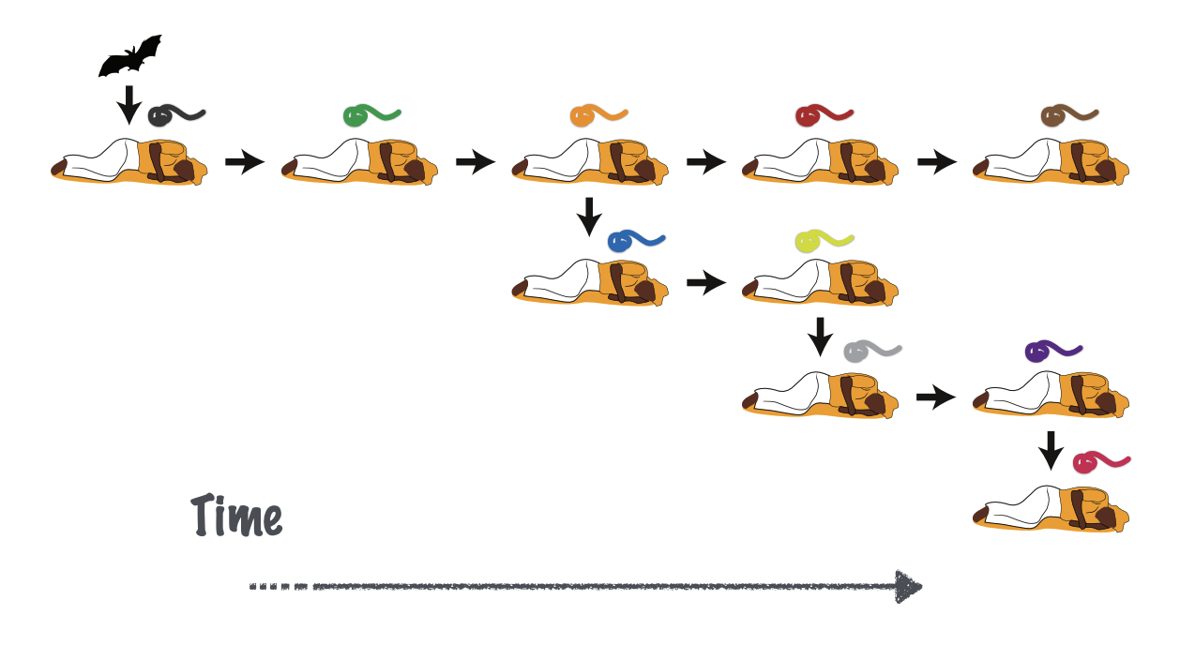
The virus evolves as it spreads between hosts
Time

Slide 8
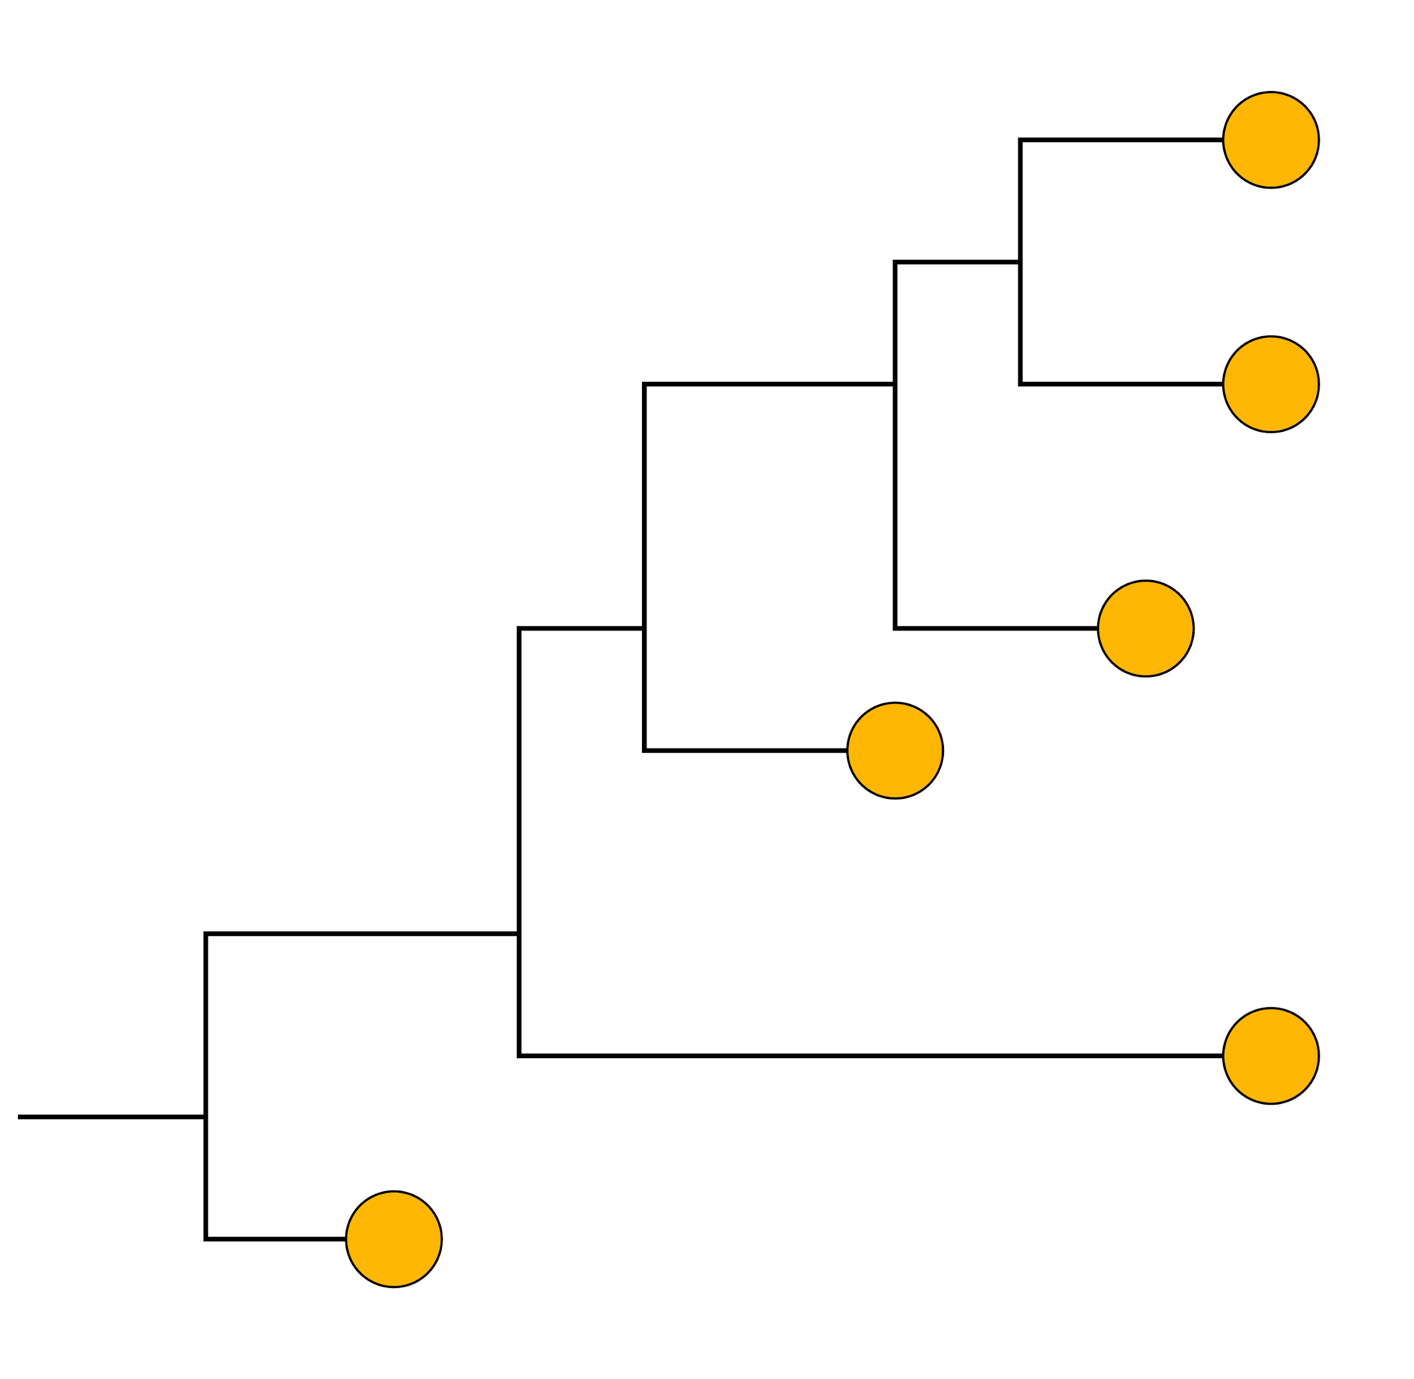
How are the pathogen sequences related?

Slide 9
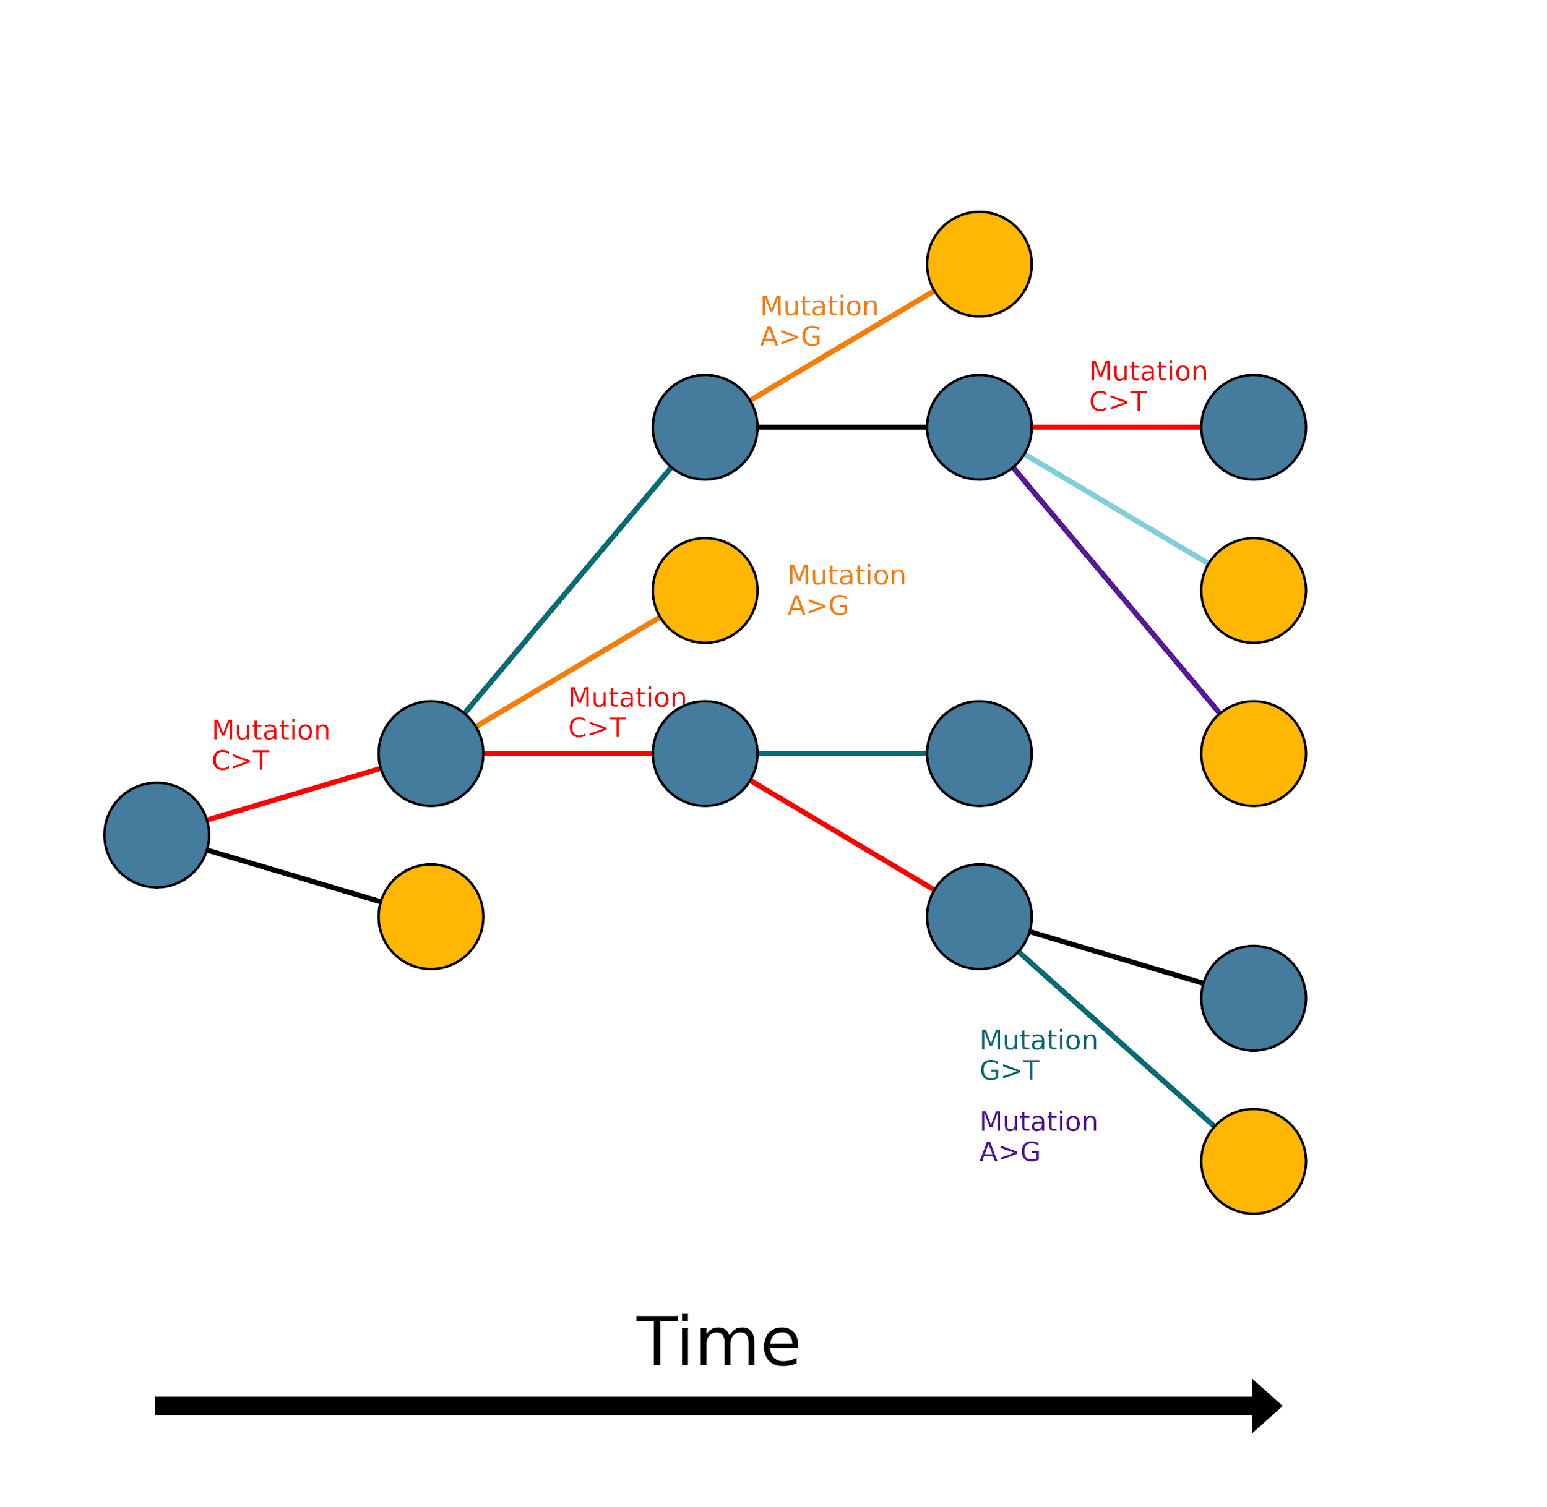
Mutations accumulate over time
Sampled
Unsampled
Time

Slide 10
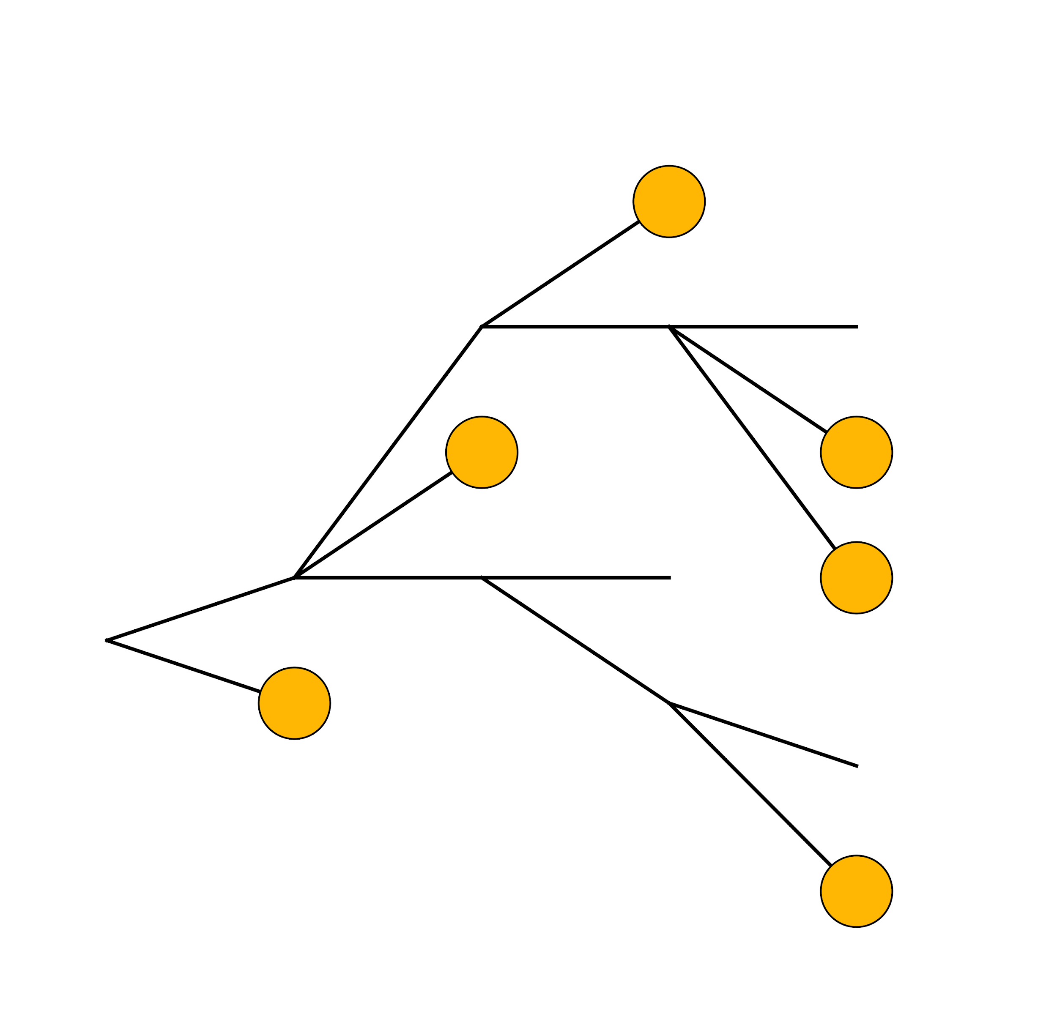
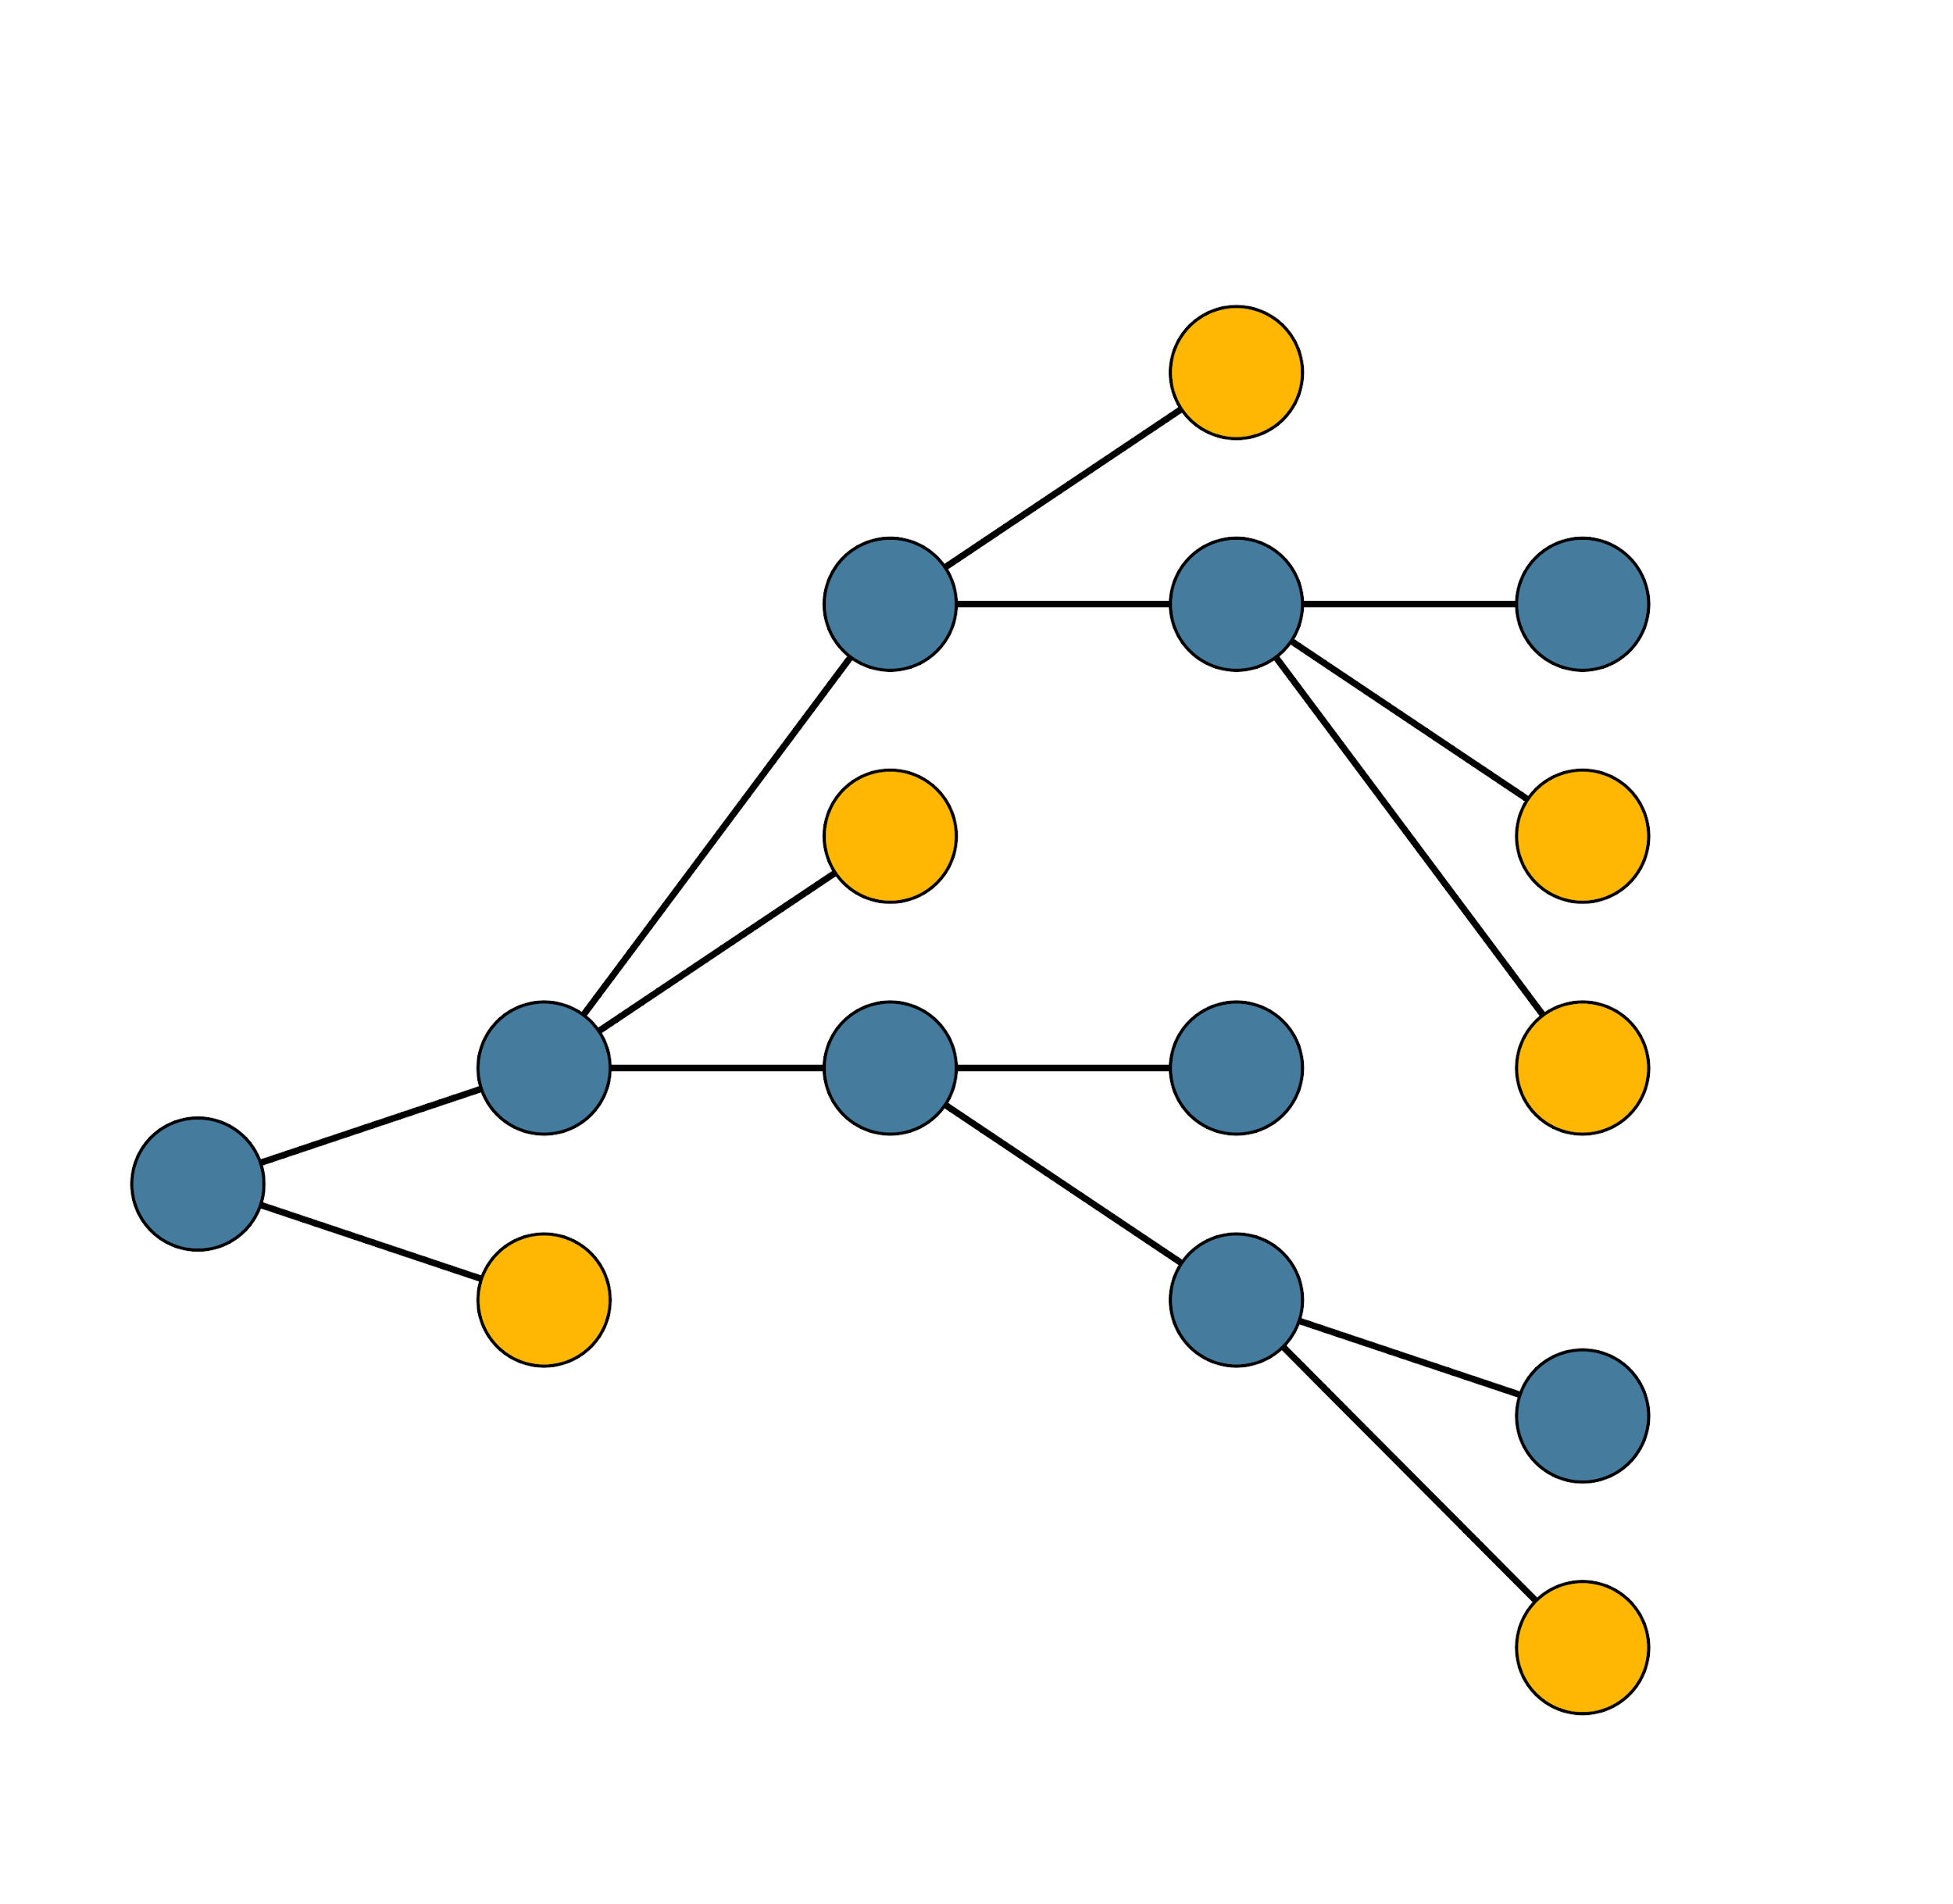
Reconstructing epidemic spread with phylogenetics

Slide 11
Phylogenies reconstruct evolutionary relationships among sampled genomes

Slide 12
Genomes must be aligned for phylogenetics
Genome 1: GTCTCGGCTC
Genome 2: GTGTCGGCTA
Genome 3: GTGTCAGCTA
Genome 4: GTGCCAGCTA
Genome 5: GGGCCATCTA
Genome 6: ATGCCAGCTA

Slide 13
Genomes must be aligned for phylogenetics
Genome 1: GTCTCGGCTC
Genome 2: GTGTCGGCTA
Genome 3: GTGTCAGCTA
Genome 4: GTGCCAGCTA
Genome 5: GGGCCATCTA
Genome 6: ATGCCAGCTA
GTCTCGGCTC
GTGTCGGCTA
GTGTCAGCTA
GTGCCAGCTA
GGGCCATCTA
ATGCCAGCTA

Slide 14
Sequence data is used to create phylogenetic trees
GTCTCGGCTC
GTCTCGGCTC
GTGTCGGCTA
GTGTCAGCTA
GTGCCAGCTA
GGGCCATCTA
ATGCCAGCTA
GTGTCGGCTA
GTGTCAGCTA
GTGCCAGCTA
GGGCCATCTA
ATGCCAGCTA
Genetic change

Slide 15
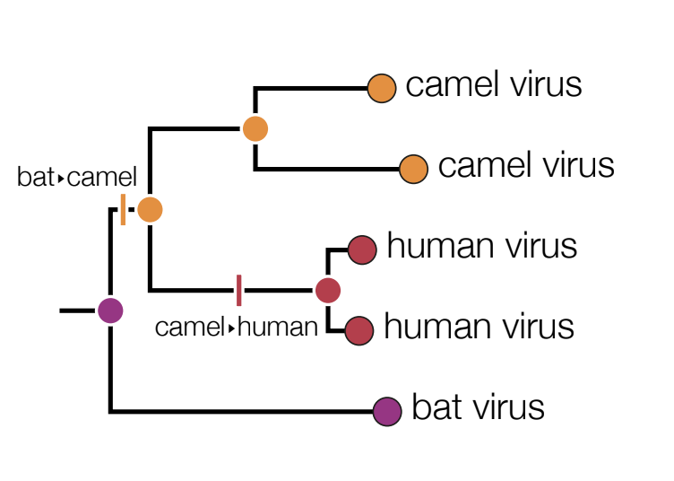
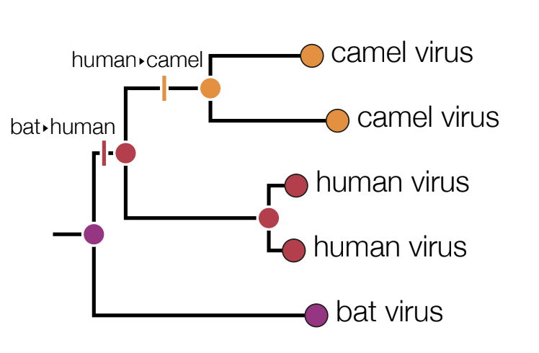
Slide adapted from Andrew Rambaut
Notes:
So here for example, you can see the tips are the same in terms of what host they live in, but the reconstruction of what state the nodes are changes the direction of the virus transfer. It also means that bats and humans don’t transfer the virus but camels and humans do in this example
This can be very important for things like host transfer where the direction and frequency of host transfer can drastically alter your public health strategy (more on this later)

Slide 16
Phylogenetic trees are not transmission trees

Slide 17
Mutations underlie phylogenies
Sequences that have the same mutations group together
Some mutations are unique, some shared
SNP = Single Nucleotide Polymorphism
GTCTCGGCTC
GTGTCGGCTA
GTGTCAGCTA
Clade
GTGCCAGCTA
G
GGGCCATCTA
ATGCCAGCTA
Genetic change

Slide 18
Mutations underlie phylogenies
GTCTCGGCTC
Multiple Sequence Alignment
T
GTCTCGGCTC
GTGTCGGCTA
GTGTCAGCTA
GTGCCAGCTA
GGGCCATCTA
ATGCCAGCTA
GTGTCGGCTA
GTGTCAGCTA
Clade
GTGCCAGCTA
G
G,T
GGGCCATCTA
ATGCCAGCTA
Genetic change

Slide 19
Mutations underlie phylogenies
G
GTCTCGGCTC
Multiple Sequence Alignment
T
GTCTCGGCTC
GTGTCGGCTA
GTGTCAGCTA
GTGCCAGCTA
GGGCCATCTA
ATGCCAGCTA
GTGTCGGCTA
GTGTCAGCTA
Clade
GTGCCAGCTA
G
G,T
GGGCCATCTA
ATGCCAGCTA
Genetic change

Slide 20
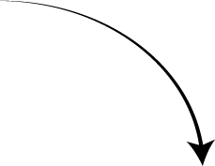
Reading phylogenetic trees
Mutations
Tips
GTCTCGGCTC
Units = nucleotide substitutions
GTGTCGGCTA
Common ancestor
(internal node)
GTGTCAGCTA
0.02
GTGCCAGCTA
Root
GGGCCATCTA
ATGCCAGCTA
Branch
Genetic change
Notes:
The Tips: the tips (external nodes)
correspond to (usually) extant taxa
the internal nodes
correspond to ancestral (hypothetical) common ancestors
the root is the hypothetical common ancestor of all the taxa
the branches
correspond to evolutionary lineages

Slide 21
Hotspot
Glo-Mobile-wifi pw: h0ra46j7
ACEGIDmifi acegid321

Slide 22












How to read a tree
This axis has no meaning (usually)
0.95
species1
0.65
species2
_{1.0} species3
1.0
C
species4
1.0
A
species5
1.0
species6
B
0.51
species7
species8
1.0
species9
species10
0. 07
Genetic change/divergence or time

Slide 23
Common ancestors
Most Recent Common Ancestor (MRCA) Last Common Ancestor(LCA)
wolf
dog otter skunk cat elephant
elephant shrew possum echidna platypus

Slide 24
Common ancestors
wolf
dog otter skunk cat elephant
elephant shrew possum echidna platypus
Common Ancestor (but not the most recent)

Slide 25
Common ancestors
wolf
dog otter skunk cat elephant
elephant shrew possum echidna platypus
Most Recent Common Ancestor
of wolf and elephant

Slide 26
Common ancestors
wolf
dog otter skunk cat elephant
elephant shrew possum echidna platypus
Most Recent Common Ancestor
of eutherian mammals

Slide 27
How to read a tree
Otter
skunk
wolf
dog
Cat
elephant
elephant shrew
possum
echidna
platypus

Slide 28
How to read a tree
Cat
⮮Î
Otter
skunk
wolf
dog
elephant
elephant shrew
possum
echidna
platypus

Slide 29






How to read a tree
species9
species8
species7
species10
species6
species1
species5
species2
species4
0. 07
species3

Slide 30

How to read a tree
species9
species8
species7
species10
These angles are spaced uniformly
Genetic change/divergence or time
species6
species1
species5
species2
species4
0. 07
species3

Slide 31
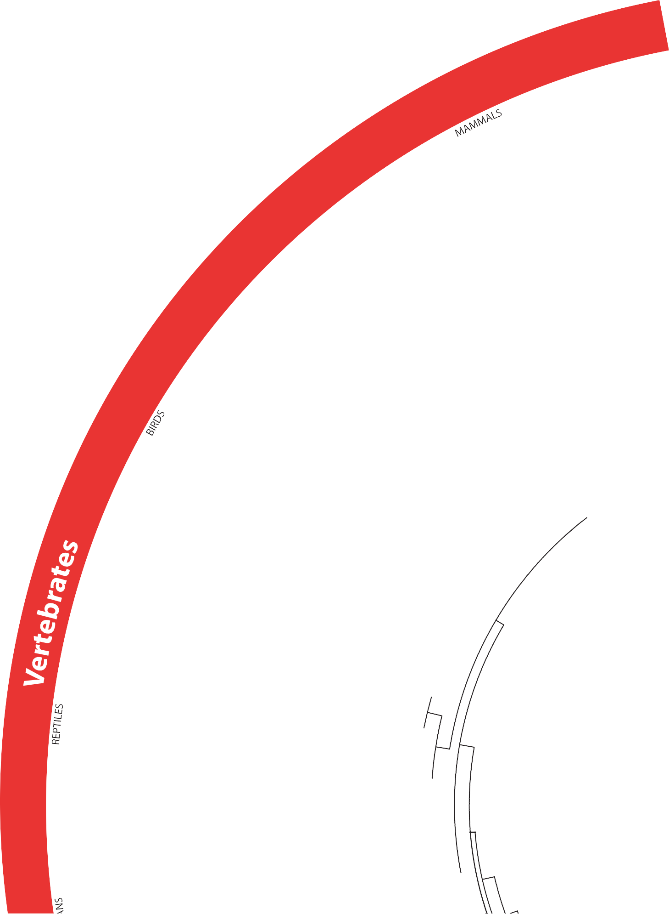

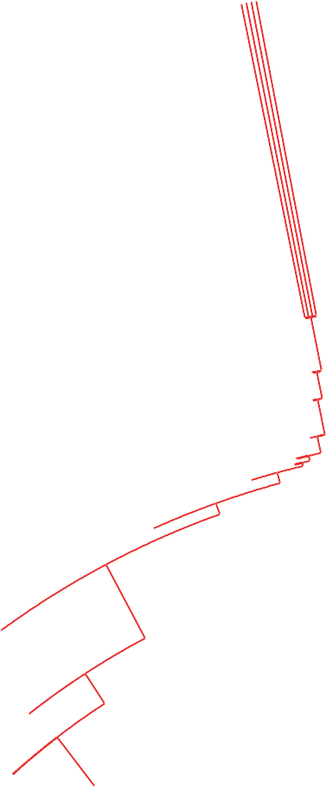

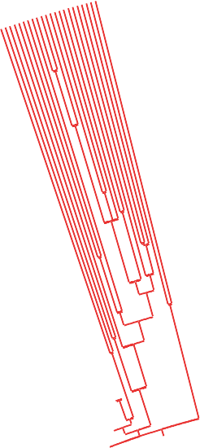
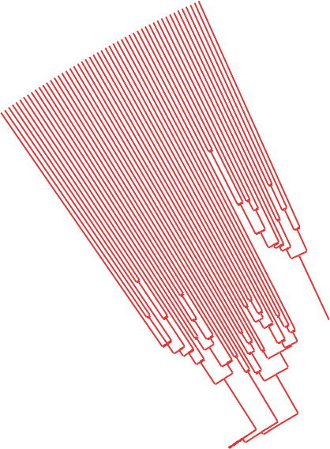
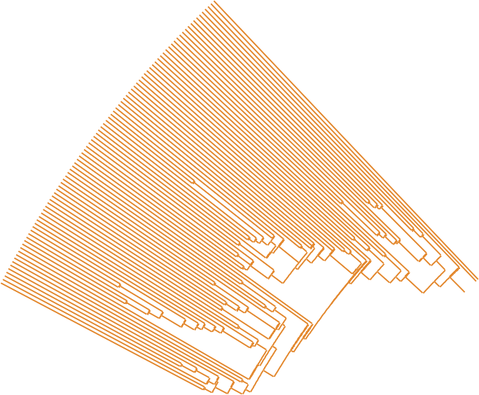
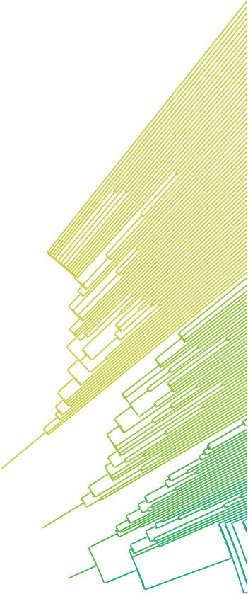






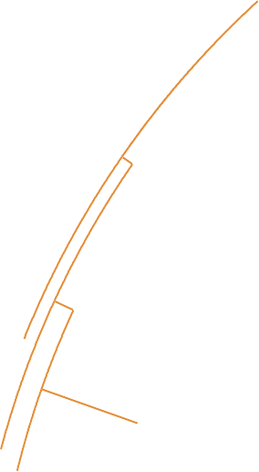





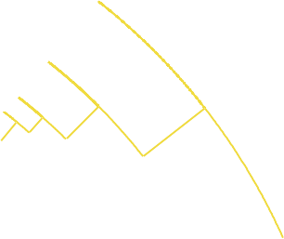








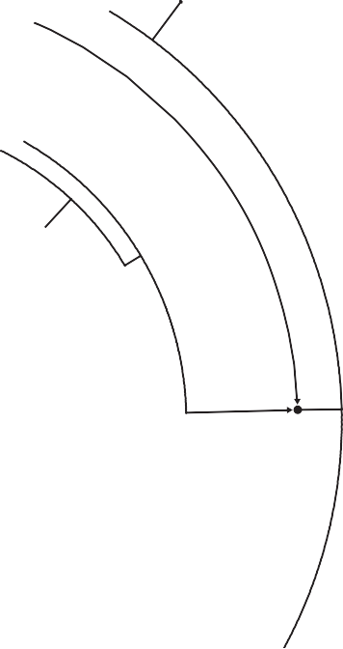










How to read a tree
Notes:
Circular ones tend not to be used because it’s harder to see the data in a lot of ways clearly. They are good at showing diversity and showing distribution of phenotypes and stuff, so that’s what they’re often used for.

Slide 32
Other visualisations
Mate et al (2015) Molecular evidence of sexual transmission of Ebola Virus, NEJM, 373, p2448-2454
Notes:
Also haplotype networks. Shows different information to phylogenies, more focused on transmission patterns. Haplotype is a set of characteristic SNPs which define a lineage, and you track that through the human population.
Lots of epidemiologists like to use haplotype networks.
Personal preference

Slide 33




How to read a tree
species8
species9
species10
species7
species6
Genetic change/divergence or time
0. 07
species5
species1
species4
species3
species2

Slide 34



How to read a tree
species8
species9
These angles are arbitrary
species10
species7
species6
Genetic change/divergence or time
0. 07
species5
species1
species4
species3
species2

Slide 35
How to read a tree
Trees can be drawn on any angle
Certain fields tend to prefer particular directions
time
time
time

Slide 36
Outline
Why do we build phylogenies?
How do we read phylogenies?
How do we build phylogenies?
How do we root trees?
What is bootstrapping?

Slide 37
How do we build phylogenetic trees?
Need to measure genetic distance between sequences.
Multiple Sequence Alignment
GTCTCGGCTC
GTGTCGGCTA
GTGTCAGCTA
GTGCCAGCTA
GGGCCATCTA
ATGCCAGCTA

Slide 38
Observed distance between sequences
GTCTCGGCTA
GTGTCGGCGA

Slide 39
Observed distance between sequences
GTCTCGGCTA
GTGTCGGCTA
GTGTCGGCGA
P-distance: 2/10

Slide 40
Observed distance between sequences
 | Seq 1 | Seq 2 | Seq 3 | Seq 4 | Seq 5 | Seq 6
Seq 1 | 0 | 3 | 1 | 2 | 3 | 4
Seq 2 | 3 | 0 | 2 | 3 | 4 | 5
Seq 3 | 1 | 2 | 0 | 1 | 2 | 3
Seq 4 | 2 | 3 | 1 | 0 | 1 | 2
Seq 5 | 3 | 4 | 2 | 1 | 0 | 1
Seq 6 | 4 | 5 | 3 | 2 | 1 | 0
GTCTCGGCTC
GTGTCGGCTA
GTGTCAGCTA
GTGCCAGCTA
GGGCCATCTA
ATGCCAGCTA

Slide 41
Branch lengths represent genetic distance
G
GTCTCGGCTC
T
GTGTCGGCTA
GTGTCAGCTA
GTGCCAGCTA
G
G,T
GGGCCATCTA
ATGCCAGCTA
Genetic distance

Slide 42
Branch lengths represent genetic distance
Vertical distance means nothing
Add horizontal branch lengths to get distance between two sequences
G
G,T
GGGCCATCTA
ATGCCAGCTA
Genetic distance

Slide 43
How are the nucleotides changing?
A
Ancestral nucleotide
T
T
We have to infer a lot of genetic change which we can’t observe.
T
C
Children nucleotides

Slide 44
Multiple substitutions can happen at same position
G
At position 2, not just T>G: T>A>G
G,T
GGGCCATCTA
ATGCCAGCTA
Uncorrected genetic distance underestimates evolutionary distance

Slide 45
How do we build phylogenetic trees?
Multiple Sequence Alignment
Nucleotide substitution model
GTCTCGGCTC
GTGTCGGCTA
GTGTCAGCTA
GTGCCAGCTA
GGGCCATCTA
ATGCCAGCTA
A
G
Model selection
C
T

Slide 46
Understanding substitution models
Model describes the process of evolution
Allows us to correct distances for multiple substitutions
Parameter: relative frequnecies of the four nucleotides
Parameter: relative rates of pairwise substitutions (e.g., rate of A to C mutation)
v
A
G
w
u
z
x
C
T
y

Slide 47
How do we build phylogenetic trees?
A
G
GTCTCGGCTC
GTGTCGGCTA
GTGTCAGCTA
GTGCCAGCTA
GGGCCATCTA
ATGCCAGCTA
C
T
Multiple sequence alignment
Substitution model
Phylogenetic tree

Slide 48
There are several methods of building trees
Distance-based neighbor-joining
Parsimony
Maximum likelihood
Bayesian

Slide 49
Outline
Why do we build phylogenies?
How do we read phylogenies?
How do we build phylogenies?
How do we root trees?
What is bootstrapping?

Slide 50
There are many ways to root a tree
Outgroup rooting
Midpoint rooting
Molecular clock

Slide 51
Rooting a tree
The outgroup is one or more taxa that are known to have diverged prior to the group being studied (the ingroup).
We can rearrange the tree so the outgroup diverges first.
The root represents the most recent common ancestor of the ingroup and outgroup taxa.

Slide 52
Trees must be rooted
G
GTCTCGGCTC
T
GTGTCGGCTA
GTGTCAGCTA
GTGCCAGCTA
G
Ancestor
G,T
GGGCCATCTA
ATGCCAGCTA
ATGCCAGCTA
Genetic distance

Slide 53
Rooting a tree
wolf dog
otter skunk
cat
elephant elephant shrew
possum
outgroup
echidna
platypus

Slide 54
Rooting a tree
wolf dog otter skunk cat
elephant elephant shrew
Ingroup MRCA
possum
outgroup
echidna platypus

Slide 55
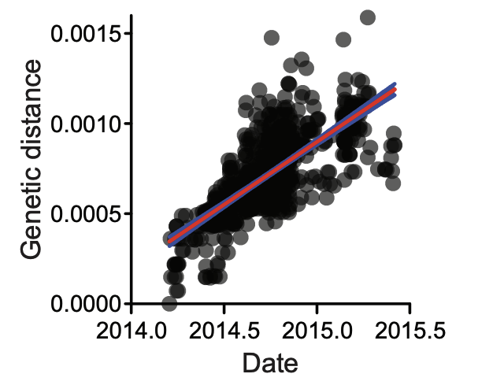
Model evolutionary rate with the molecular clock
Molecular clock: relationship between genetic change and time
Helps us understand the rate of evolution
Can be used to understand directionality of evolutionary events

Slide 56
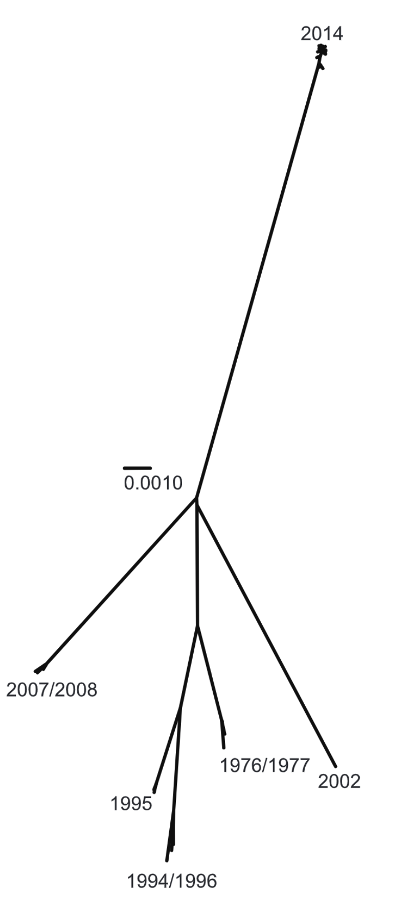
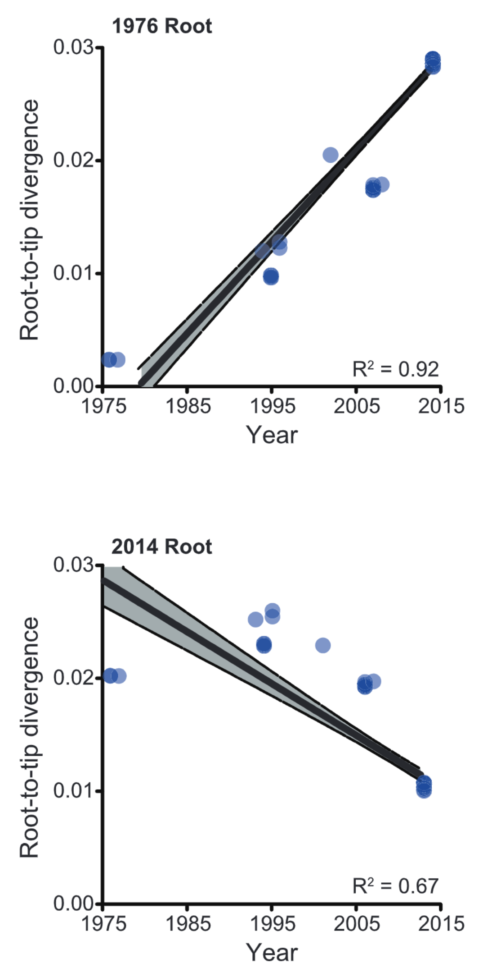
What happens when you choose the wrong root?
Gire et al. 2014. Science

Slide 57
Misinterpretation of Evolutionary Relationships:
Temporal Misconceptions:
Directionality of Traits:
Implications for Biogeographical Studies:
Distortions in Analyses:
Affecting Downstream Comparative Analyses:

Slide 58
Outline
Why do we build phylogenies?
How do we read phylogenies?
How do we build phylogenies?
How do we root trees?
What is bootstrapping?

Slide 59
How do we build phylogenetic trees?
A
G
GTCTCGGCTC
GTGTCGGCTA
GTGTCAGCTA
GTGCCAGCTA
GGGCCATCTA
ATGCCAGCTA
C
T
Multiple sequence alignment
Substitution model
Phylogenetic tree
Bootstrapping

Slide 60
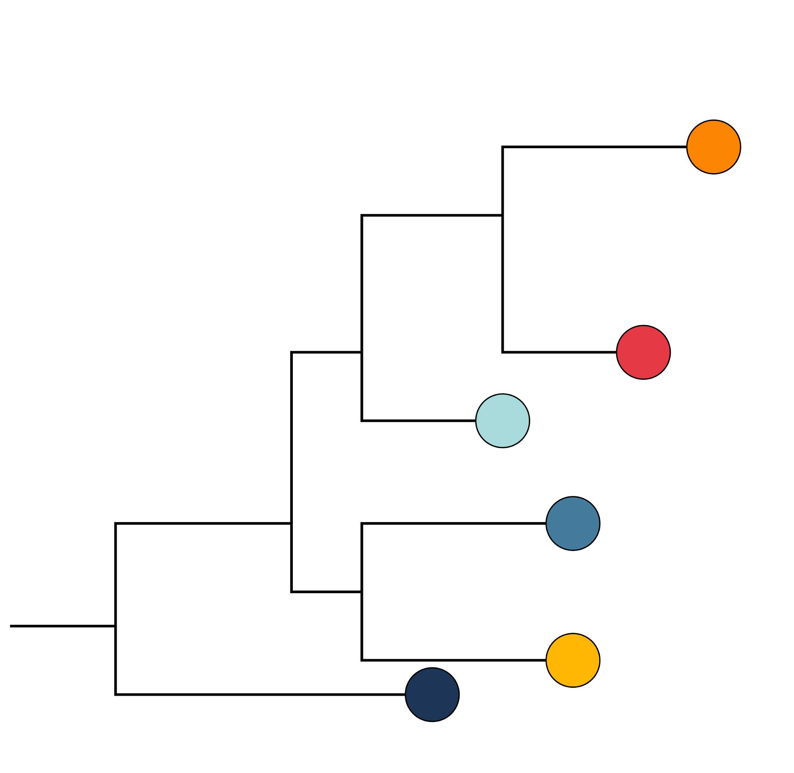
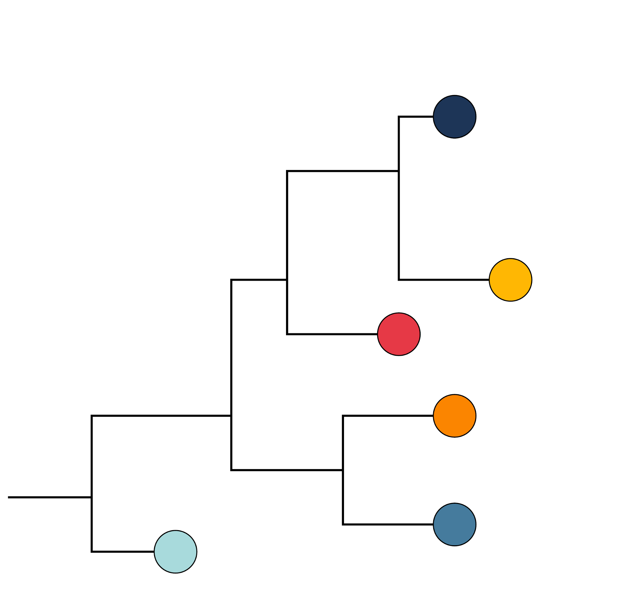
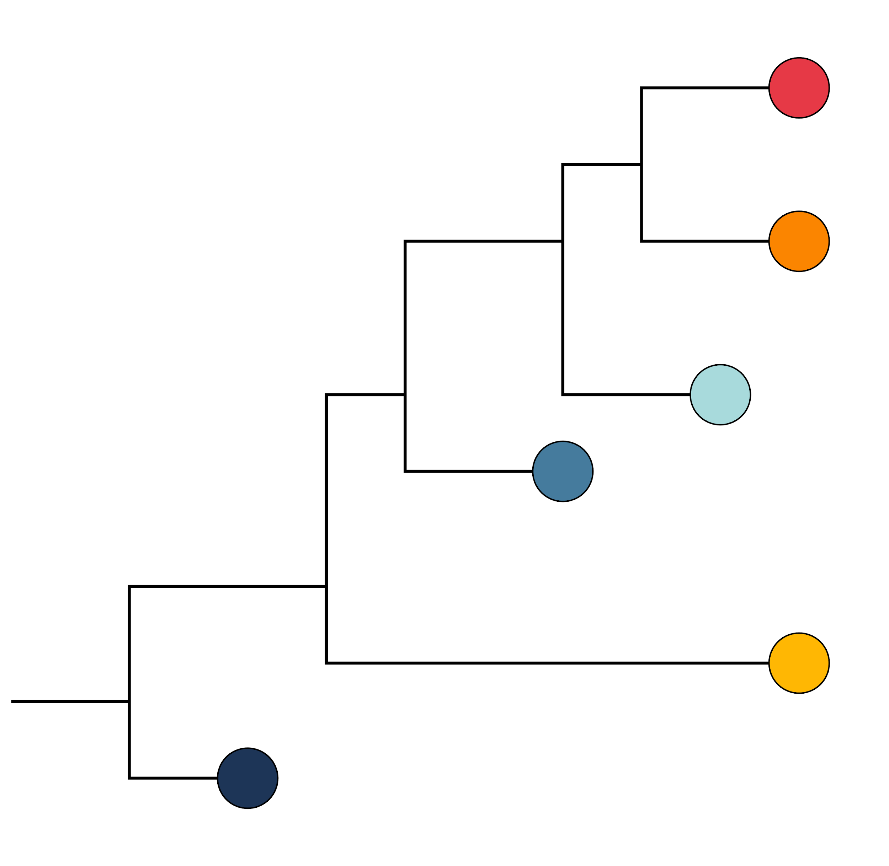
What is bootstrapping?
Maximum likelihood phylogenetic approaches produce a single best tree
It does not quantify how much you can trust the tree
How much uncertainty is there in evolutionary relationships in the tree?
That’s where bootstrapping comes in!

Slide 61
What is bootstrapping?
If the data (alignment) is slightly different, would it still support the same tree?
“Bootstrap support" is the number of times that a grouping appears in the collection of trees

Slide 62
Assumptions of phylogenetic reconstruction
Relationships among taxa can be represented by a tree
Violated by recombination, reassortment, horizontal gene transfer
Homologous characters are being compared
Assumes shared ancestry
Assumes multiple sequence alignment is valid
Evolution at each site is independent

Slide 63
Assumptions of phylogenetic reconstruction
Relationships among taxa can be represented by a tree
Violated by recombination, reassortment, horizontal gene transfer
Homologous characters are being compared
Assumes shared ancestry
Assumes multiple sequence alignment is valid
Evolution at each site is independent
Data is assumed to be correct

Slide 64
Summary
Phylogenies reconstruct evolutionary relationships among sampled genomes
There are many ways to build trees
Branch lengths show us the genetic distance between sequences
With the right root, we can understand ancestor-descendant relationships
We can test the reliability of our trees with bootstrapping

